Slide 1

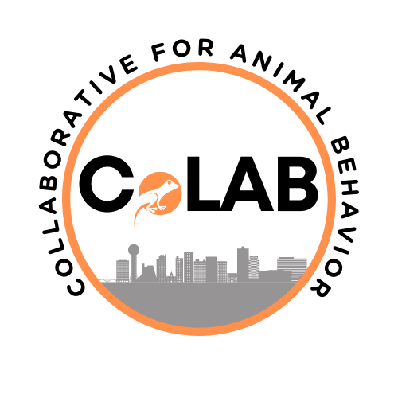
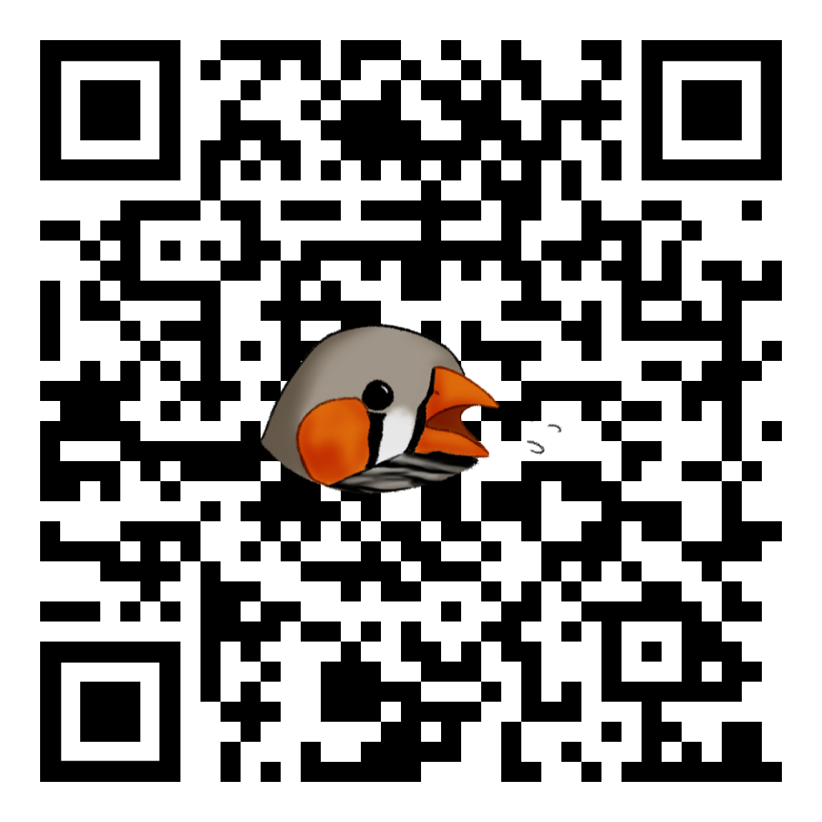

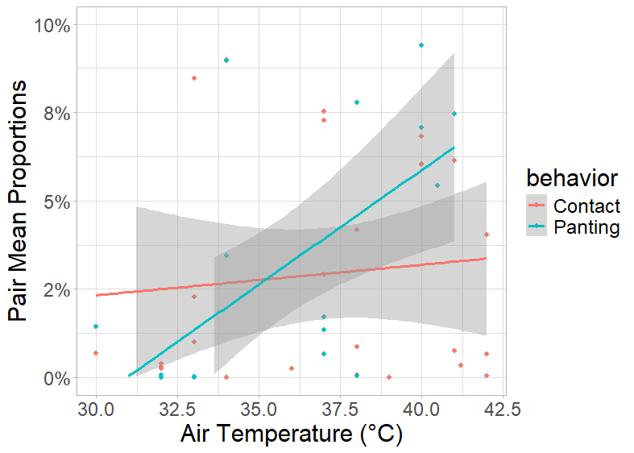
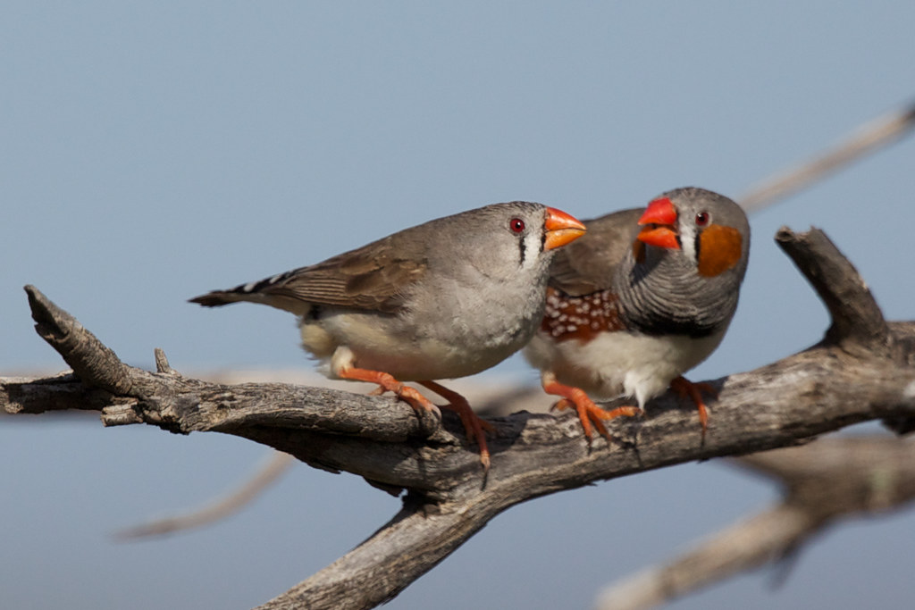
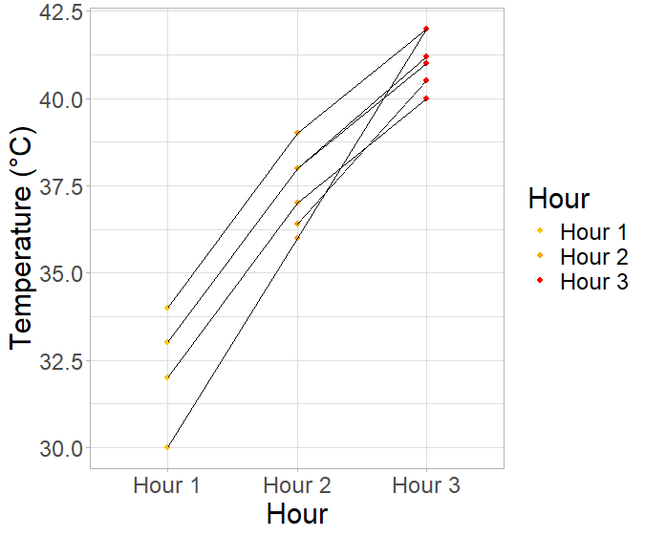

Seth Shaw, Juan D. Zuluaga, Tara Empson, and Elizabeth P. Derryberry
The University of Tennessee, Knoxville
Investigating the impact of temperature on male zebra finch (Taeniopygia castanotis) social interactions
Background
Results
Heatwaves are negatively impacting wildlife, putting small endotherms at high risk¹.
Previous work has largely examined the impact of heat on single individuals.
There is evidence that these climatic events impact group social behaviors².
Hypothesis & Prediction
We hypothesize that heat impacts group social dynamics.
We predict that at higher temperatures, males will spend more time performing thermoregulatory behaviors and less time engaging in social behaviors.
This Photo by Unknown Author is licensed under CC BY-NC-ND
We found panting significantly increased with temperature (p<0.01).
There was no significant relationship between physical contact and temperature (p>0.05).
Methods
10 male pairs
3-hr temp trial. Each hour a different temp
Each temp selected within a range (32-34, 37-39, 40-42°C)
Last 30-min of each hour scored for:
Physical contact
Panting
Data analyzed using negative binominal mixed effect models
Discussion
Increased temperatures seem unlikely to impact the proportion of time zebra finches spend interacting socially.
Experimental temperatures are not representative of the full range of temperatures in the wild. An effect may only become apparent near the upper limit of their thermal tolerance.
Future Directions
Examine other facets of social behavior, like vocal interaction, in this context.
Examine thermoregulation in different social contexts.
Seth Shaw
sshaw33@vols.utk.edu
EEB Senior
University of Tennessee Knoxville
Funding
The National Science Foundation (Award #2032412 to EPD). University of Tennessee Advanced Undergraduate Research Activity Grant & Undergraduate Research Travel Grant (SPS)
Acknowledgements
The Spring 2025 Vivarium care team: John Humphrey, Austin Miller, Georgia Smith, Mack Sartino, and Tamara Smith. Sasha Ewing for managing the lab. Tara Empson, Juan Zuluaga, and Elizabeth Derryberry for mentoring and assisting with this project. Tara Empson for zebra finch art.
References
[1]Conradie, S. R., Woodborne, S. M., Wolf, B. O., Pessato, A., Mariette, M. M., & McKechnie, A. E. (2020). Avian mortality risk during heat waves will increase greatly in arid Australia during the 21st century. Conservation Physiology, 8(1), coaa048.
[2]Funghi, C., McCowan, L. S. C., Schuett, W., & Griffith, S. C. (2019). High air temperatures induce temporal, spatial and social changes in the foraging behaviour of wild zebra finches. Animal Behaviour, 149, 33–43. https://doi.org/10.1016/j.anbehav.2019.01.004

